Slide 1
Wheel & Tire Tech Session
September 12, 2020
10:00 AM CDT
Presented by Houston MG Car Club

Slide 2
History
Original tires were leather or steel
John Boyd Dunlop of Ireland produced the first production pneumatic tire

Slide 3
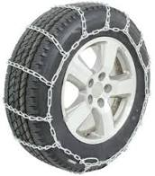
Tire Treads
Slicks – No grooves, provides maximum contact area for higher traction
Mud & Snow (M&S) – Larger deeper slots to engage mud and snow(All season radial)
Snow – Deep tires some have studs to grip in ice but can damage road surface
Chains -

Slide 4
Wear
Tires an wear due to several factors:
Poor alignment wearing inner and outer ribs
Rocky terrain
Under inflation causing wear to outer ribs
Unbalanced wheels causing uneven wear
Tread wear indicators show minimum tread
Damage by aging
Thermo oxidation degradation caused by time, temperature, flex fatigue, UV exposure

Slide 5
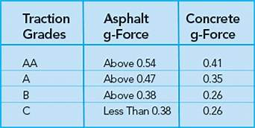
Traction Grades

Slide 6
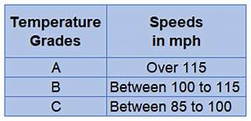
Temperature Grades

Slide 7
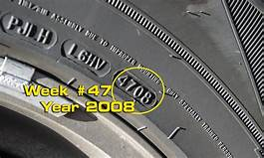
Date Code
Tires should not be more than 10 years old.

Slide 8
Load Indexes
The higher the tire's load index number, the greater its load carrying capacity
Examples:
89 = 1,279 pounds 88 = 1,235 pounds 87 = 1,201 pounds 86 = 1,168 pounds 85 = 1,135 pounds

Slide 9
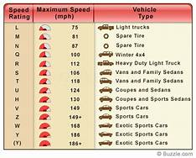
Speed Rating

Slide 10
EuropeanTire Noise Rating
The external noise generated by the tire is indicated both in decibels (dBs) and by black sound waves that indicate the noise class of the tire, from 1 (quiet) to 3 (loud)
• 1 black sound wave: Already 3dB below the 2016 European limit • 2 black sound waves: Already com­pliant with the 2016 European limit • 3 black sound waves: Compliant with the 2012 European limit

Slide 11
Tire Tread Material
The most common elastomer material used today is a styrene-butadienecopolymer. It combines the properties of polybutadiene, which is a highly rubbery polymer and thus offering good wet grip properties, with the properties of polystyrene, which is a glassy polymer and thus offering low rolling resistance in addition to wear resistance.
Therefore, the ratio the two monomers in the styrene-butadiene copolymer is considered key in determining its grip and wear resistance properties.

Slide 12
Tubeless vs Tube-Type
Tubeless tires are considered safer because they do not loose air suddenly when punctured
Tubeless tires stay cooler as there is less friction
Tubeless tires are easier to balance as there is less uneven weight
Tires with tubes are better suited to wire wheels due to sealing around the spokes

Slide 13
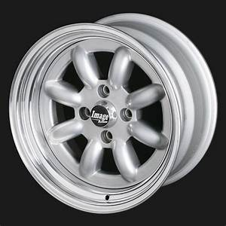
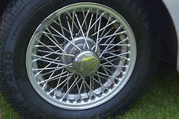
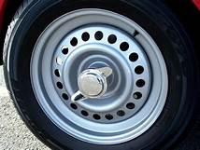
Wheels
Alloy wheel
Wire wheel
Steel wheel

Slide 14
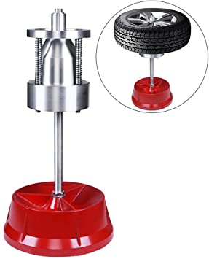
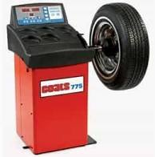
Tire Balancing
Static balancing
Dynamic Balancing

Slide 15
Lug Centric vs Hub Centric
Hub Centric Wheels are centered by the center bore of the wheel and the hub flange.
Lug centric wheels are centered by the torque of the lug bolts; rather than the center bore of the wheel and the hub flange

Slide 16
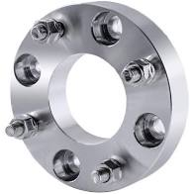
Wheel Adapters
Can be used to located lug centric wheels on balancing machine
Can be use to increase track width

Slide 17
Trailer Tires
Usually stay in sunlight and do not move
This leads to premature wear
Typically 4 year life

Slide 18
Thank You
Our sincere thanks to Mr Miles Sandy of Discount Tire.

